Slide 1


Major Project Presentation On
Digital Negotiation Factory
By
Dushyant Singh (Reg. No.: 201700066)
Group ID: SE-54
Under guidance of
Mr. Rajesh Prasad
Manager, CAM IT Proc. & GSP, TATA STEEL
Internal Review by
Mr. Suman Kalyan Kar
(Asst. Prof. – I, Dept. of Computer Science & Engineering)
Sikkim Manipal Institute of Technology

Slide 2
Contents
Abstract 3
Introduction 4
Literature Survey 5 - 6
Problem Definition 7
Solution Strategy 8-9
Software Requirement & Specification 10-11
Design 12-15
Methodology 16-17
Implementation 18
Results and Discussions 19
Snapshots 20-24
Conclusion 25
Limitations & Future Scope 26-27
Gantt Chart 28
Acknowledgement 29
References 30

Slide 3
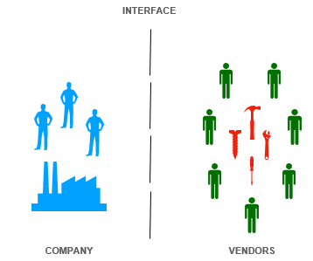
Abstract
Procurement of raw materials and shared services for steel making is secured via various vendors who bid on the tenders/orders laid out on the company portal.
In the absence of visibility of open market trends and dynamics due to unstructured details of past purchases, bulk contracting is the only leverage for price negotiation for procurement executives.
One platform is needed for catering all negotiation prerequisites (Analysis of latest market trends and price movements, auto identification of best qualifying vendors, indication of best bidding price range for negotiation).
Alongside assisting the procurement executives, the platform would also provide feedback to vendors for more competitive bidding.
This will lead to a simple user-friendly interface for assisting all procurement related users, having analytically driven negotiations, reduced negotiation time and increased supplier/vendor competitiveness.
Fig.1- Project target users

Slide 4
Introduction
The goal is to provide a simple user-friendly interface that provides assistance to all procurement related users.
Procurement executives receive a visualization of the market trends and a better understanding of the market dynamics, auto-identification of best vendors & insights into best bidding price range.
Vendors / suppliers receive a template score card that sparks more competitive bidding.
Integration of the analysis results on the backend which depend on the user input, to the front end in the interface is the primary goal

Slide 5
Literature Survey
YEAR | JOURNAL | TITLE / AUTHOR | FINDINGS | PROJECT RELEVANCE
2020 | International Journal of Engineering & Information Systems | Book’s Rating Prediction Using Just Neural Network Author: Alaa Mazen Maghari, Iman Ali Al-Najjar, Said Jamil Al-Iagtah, Samy S. Abu-Naser | Normalization is required when rating values to be predicted are very small compared to input integer parameters | We don’t need to perform normalization as input values are in the same range as ratings to be predicted

Slide 6
YEAR | JOURNAL | TITLE / AUTHOR | FINDINGS | PROJECT RELEVANCE
2003 | ELSEVIER | Credit rating analysis with support vector machines and neural networks: a market comparative study Author: Zan Huang, Hsinchun Chen, Chia-Jung Hsu, Wun-Hwa Chen, Soushan Wu | SVM (Support Vector Machine) achieved accuracy comparable to BNN (Backpropagation Neural Network) | We need to decide whether to use a neural network or a ML algorithm (SVM) to make our vendor rating prediction. As overall rating is subject to individual judgement neural network seems more feasible

Slide 7
Problem Definition
The absence of visibility of open market trends and dynamics due to unstructured details of past purchases.
Losing of negotiation window due to absence of negotiation pre-requisites (Analysis of latest market trends and price movements, auto identification of best qualifying vendors, indication of best bidding price range for negotiation.
No feedback for vendors to promote more competitive bidding.
No one-stop platform for assisting all procurement related users.

Slide 8
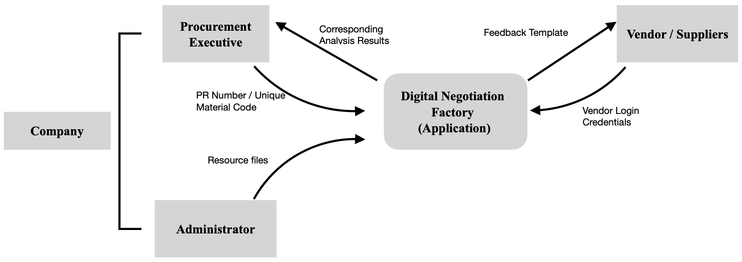
Solution Strategy
A web application which relays the results derived from the statistical modelling or processing of data in the backend to the template (web page) corresponding with the user input received at the front end is developed.
The interaction between the application, users and other involved entities is intended as following.
Fig.2- Application interaction with users and other involved entities

Slide 9
Solution Strategy (contd.)
The web application would be accessible to all as there would be no portability issue. A suitable browser is all that is needed.
Due to many libraries available mostly all data processing, analysis, statistical modelling etc. are done using the Python language. So, a python web framework for developing the web application would make it easier to relay the analysis results to the templates. Hence, we are developing web application using flask micro web framework.
The application needs two data files for processing, the first regarding the procurement details of the past and second would be the performance review of the vendors over the various orders.
The different users (vendor / company exec.) would be able to have different views as the application would direct them to their respective pipelines.
The procurement executives would receive the analysis results and visualizations corresponding to the PR number or Product ID entered by them.
The respective vendors would receive their feedbacks & visualization templates assembled for them.

Slide 10
Software Requirement & Specification
Hardware specification of the Developing environment
Modern operating system (Windows 7 or 10 & higher, Mac OS X 10, 11 or higher, 64 bit)
x86, 64-bit CPU (Intel, AMD Architecture) or apple M1 chip
Minimum 4 GB RAM
Minimum 5 GB free disk Space
Software specification
Front – End: HTML, CSS, JS, Bootstrap
Back – End: Python version 3.5+ or Python 2.7, Flask, SQL-Alchemy package, Jinja, Werkzeung, MarkupSafe, ItsDangerous, Click, WTForms, Pickle, Pandas, Numpy, Keras, Matplotlib, Scikit-Learn, pickle, h5, D3.js, Anaconda Virtual Environment.

Slide 11
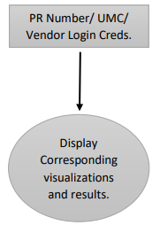
Software Requirement & Specification (contd.)
Goals of Implementation
Application to return maximum analysis results and visualizations with minimum user effort/input
Developers must be able to swap or manipulate application functions and dependencies which relay the results and visualizations after processing if changes in the template visualizations are requested.
Functional requirement
Fig.3- Interaction View of the users and the application

Slide 12
Design
The application receives PR number (Product class) or Product ID (UMC: Unique Material Code) from the procurement executives logged in for assistance. It processes the available data resources to generate analysis results and data corresponding to the user input.
These data and analysis results are relayed to the user via a template which also shows a visualization of these results.
The application returns the vendors their corresponding feedbacks when it receives their login credentials.
Each view function in the application has a corresponding template file (.html file).
The data processing and statistical modelling algorithms can be independently developed within the main application as functions or be imported from different files or packages.

Slide 13
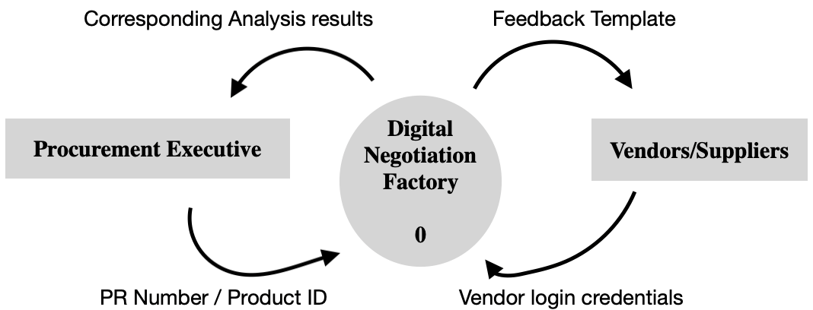
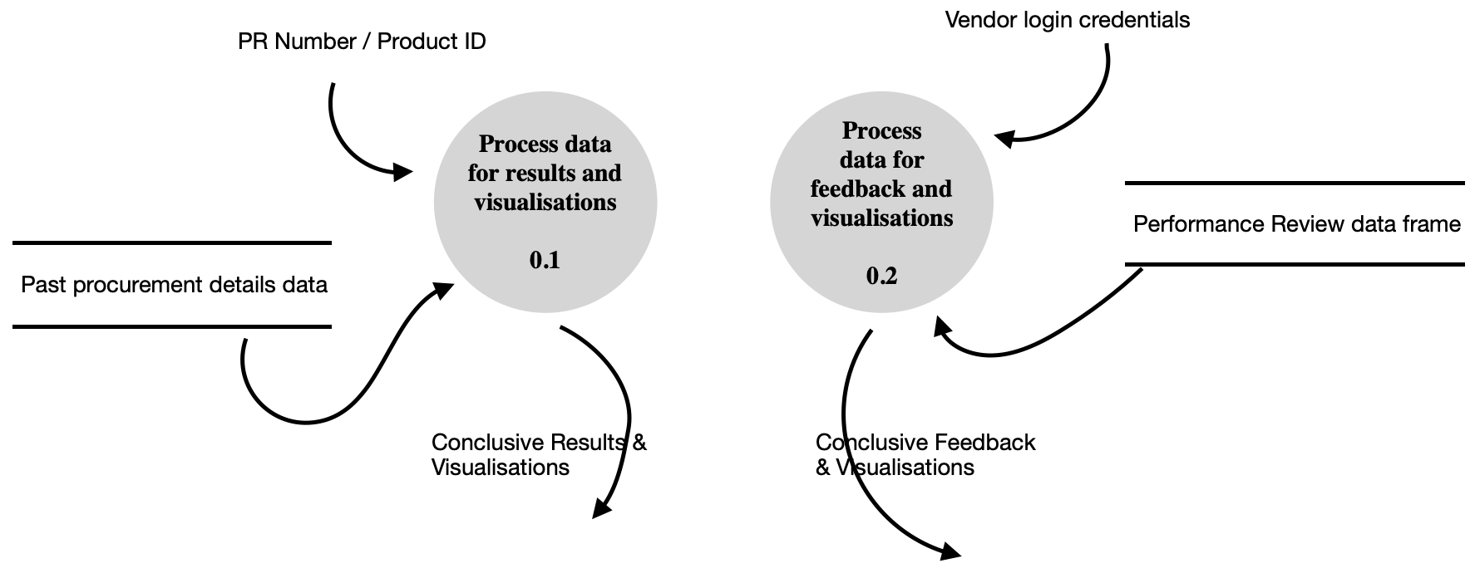
Design (contd.)
Fig. 4- Context Diagram
Fig. 5- 1st level of DFD

Slide 14
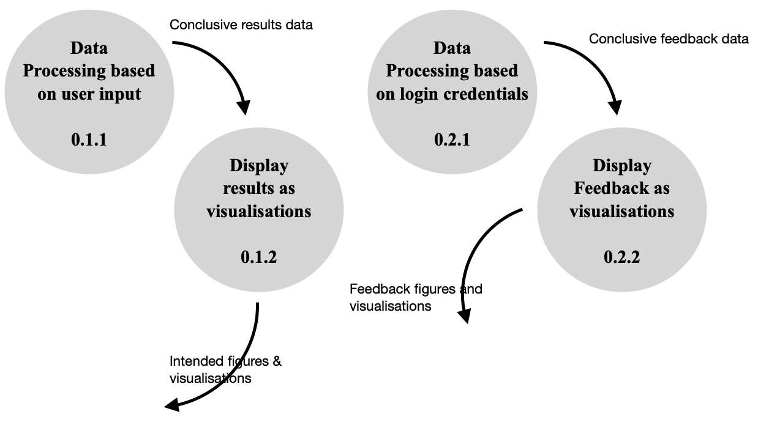
Design (contd.)
Login Creds
PR Number or Product ID
Fig.6- 2nd level of DFD

Slide 15
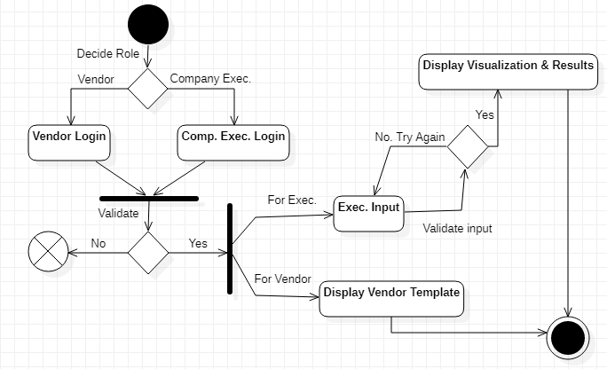
Design (contd.)
The dynamics of the functioning of the application are represented in the Activity diagram below. It depicts the pipeline the users follow to get assistance from the application.
Fig.7- Activity diagram

Slide 16
Methodology
A web application using flask micro web framework which would allow us to integrate the data processing algorithms and the web template views is developed.
Each template view function has it’s corresponding .html file to represent
Depending on whether we are using neural networks as our model or some other Machine learning model like SVM we can use h5 format or pickle package for integrating the models to our application.
The data resources will be provided by the company and managed by the Administrator. The Administrator will also be responsible for user verification and authorization.
The different views in the flask application will communicate with the processes and algorithms; and they can accept or return any kind of parameters and data respectively, it can be variables, lists, tuples, strings, etc. The algorithms, models, network models can be swapped, manipulated, and re-trained without affecting the application architecture.
The front-end templates corresponding to the different views have various scripts supporting the dashboard visualizations that we intend to provide.

Slide 17
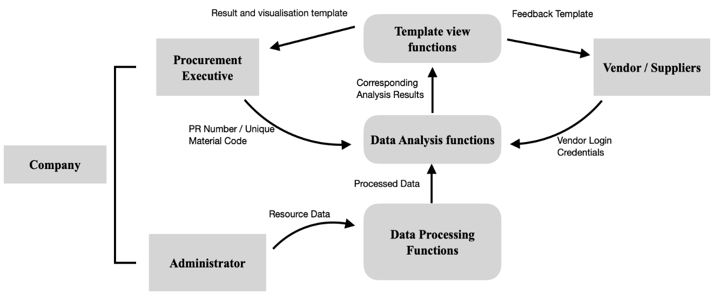
Methodology (contd.)
Fig.8- Methodology chart

Slide 18
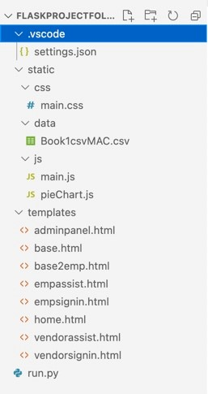
Implementation
Flask does not enforce any particular project layout. Following is a snapshot of a feasible organization of the application implemented.
The functionalities of the application can be in the main application file or be imported from other packages or files
The different views in the flask application will communicate with the processes and algorithms; and they can accept or return any kind of parameters and data respectively, it can be variables, lists, tuples, strings, etc.
The data resources will be provided by the company and managed by the Administrator. The Administrator will also be responsible for user verification and authorization.
SQL-Alchemy package can be used to create data base of authorized users by the administrator and is stored as .data file in the server along with the application.
Fig. 9: Application Organization

Slide 19
Results and Discussions
The application being developed as flask web application significantly reduced the codebase required for such an undertaking.
The function-oriented structure of the application allows us to easily mold it in response to future requirements of the users without disturbing the basic architecture.
The procurement executives saved significant negotiation window
The vendors are motivated by the feedback they received across different parameters and are now striving to be the best with a better directed approach.

Slide 20
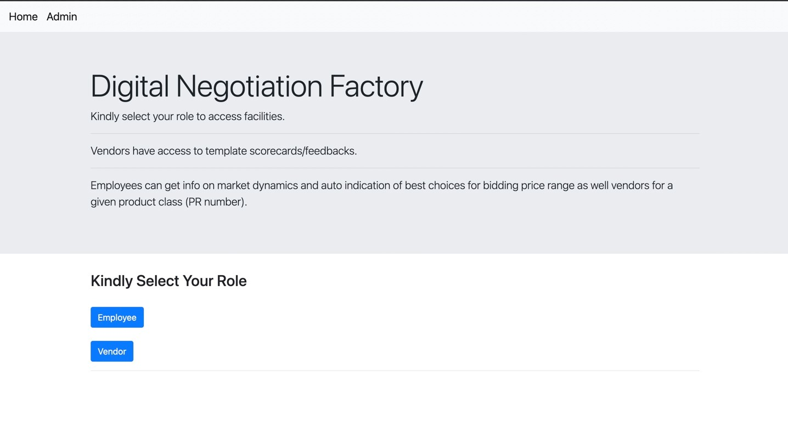
Snapshots
Fig. 10: Home Page for choosing role

Slide 21
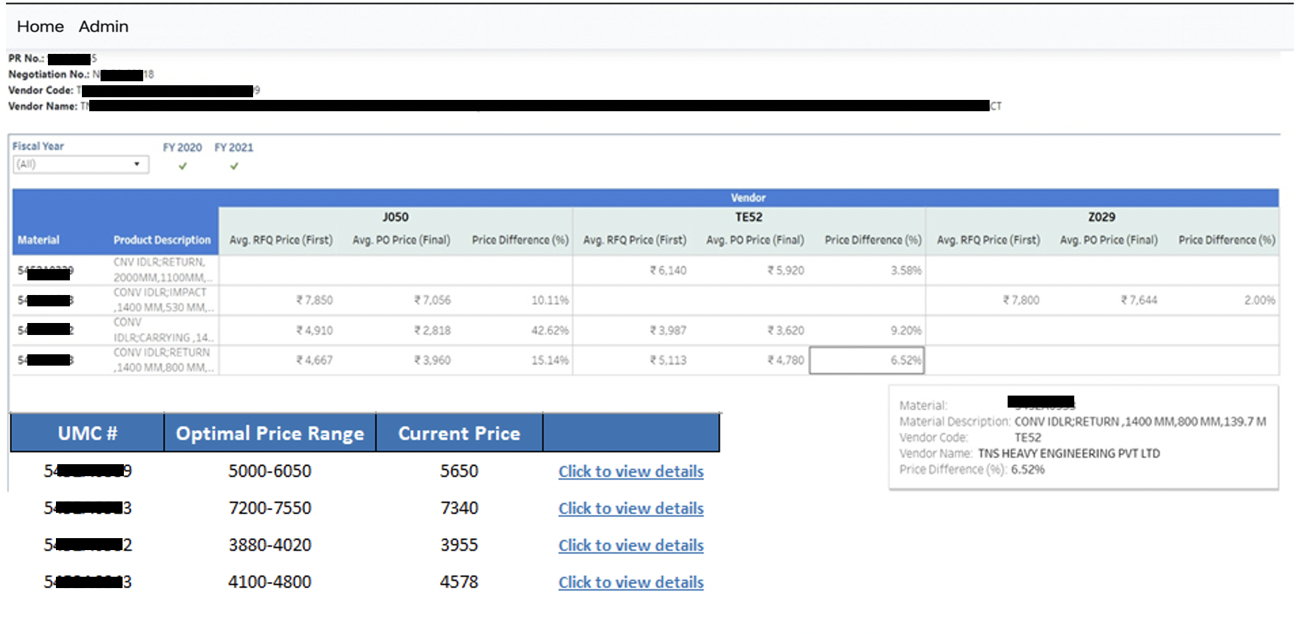
Snapshots (contd.)
Fig. 11: Executive assistance dashboard template view 1

Slide 22
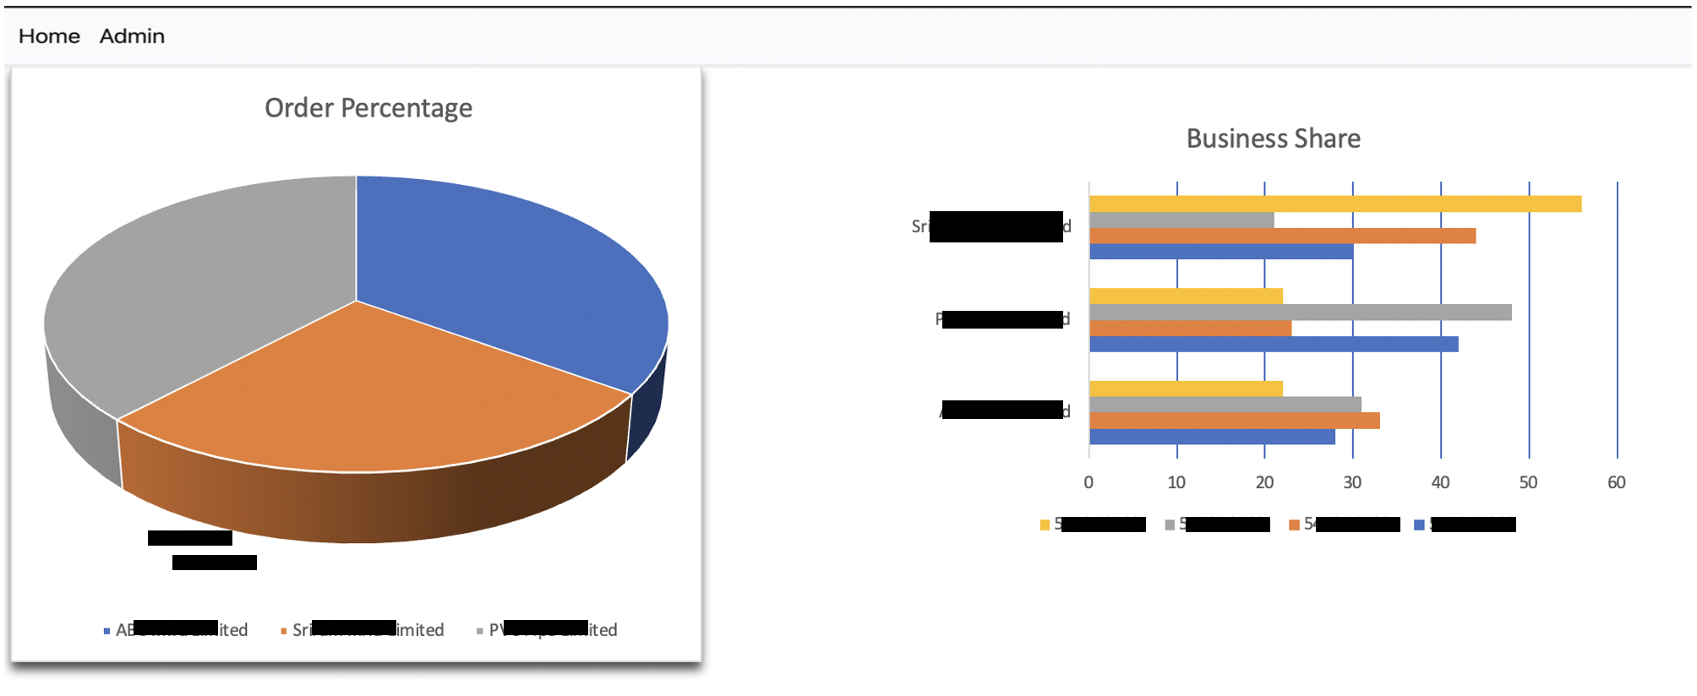
Snapshots (contd.)
Fig. 12: Executive assistance dashboard template view 2

Slide 23
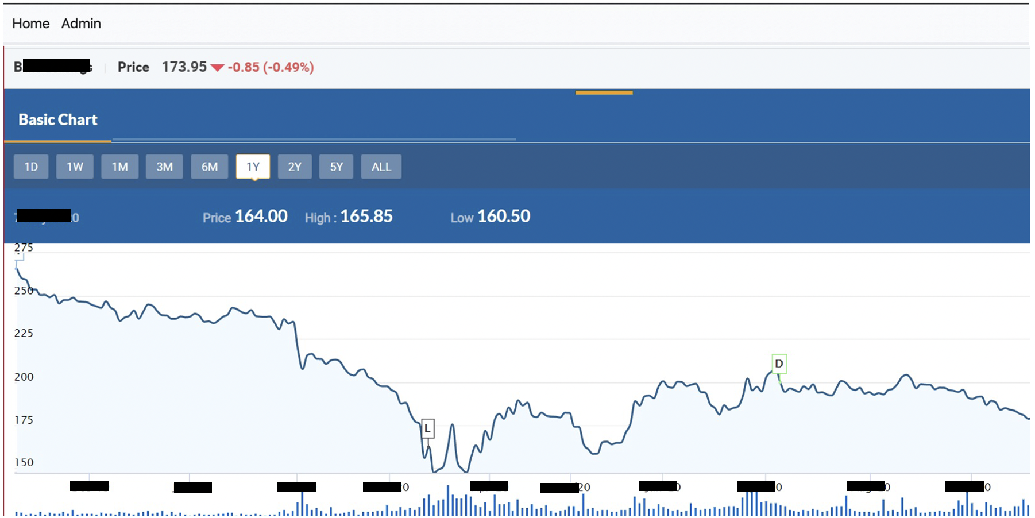
Snapshots (contd.)
Fig. 13: Executive assistance dashboard template hyperlink view

Slide 24
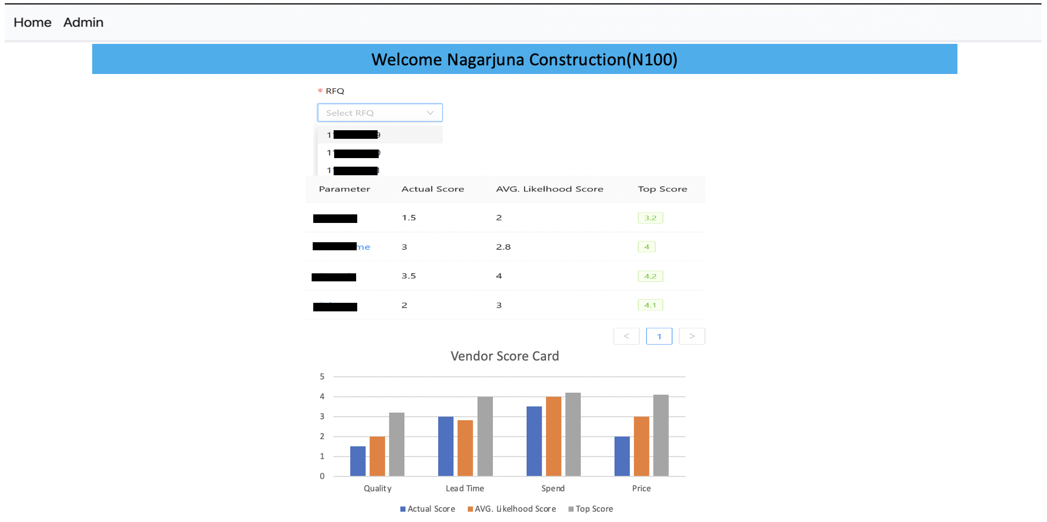
Snapshots (contd.)
Fig. 14: Vendor Feedback Template

Slide 25
Conclusion
This was a project with various themes ranging from data analysis and visualization to application development. The analysis and visualization teams provided worked to determine the best algorithms for data processing and the most helpful dashboard visualizations.
As application developers it was our job to interface the results of their analysis algorithms and visualizations to the users on a simple user-friendly interface.
It saved a lot of the time and efforts of the procurement executives and promoted competitive bidding among the vendors. This all ultimately led to economic gains for the company and better service/product quality from the vendors at more economical prices.
The development of the application required us to have knowledge of python functions, routing & redirecting concepts and other functionalities of the flask, seaborn and matplotlib packages along with other web development languages (HTML, CSS, JavaScript).

Slide 26
Limitations & Future Scope
Limitations:
Although the project has been made to the best of it but the assistance the application provides is not fully automated.
The models that learn from the data and give prediction results need to be re-trained to keep the performance at its best.
The administrator is needs to make a lot of preparations before the application is initialized and accessed by users (making authentic user data base and providing login credentials to new users).
There is no fixed time interval to update data resource files for optimum results.
Trust on the administrator is paramount.

Slide 27
Future Scope:
The application can be restructured to handle real time data for analysis, as in a corporation of this magnitude even a day’s data is worth a lot of information and insights.

Slide 28
Gantt Chart
ACTIVITY | Time Frame (For year 2021)
 | January |  |  |  |  |  | Feb |  |  |  |  | March |  |  |  |  | April |  | May
 | 29th |  |  |  |  | 31st | 1st to 15th | 16th to 28th |  |  |  | 1st to 15th | 16th to 31st |  |  |  | 1st to 15th | 16th to 30th | 1st to 15th |  | 16th to 31st
Feasibility Study
Case Study
Problem Identification
Learning Flask
Integrating Application modules
Documentation
Propose activity
Activity achieved
Fig. 15: Gantt Chart

Slide 29
Acknowledgement
I wish to express my sincere thanks to my external reviewer Mr. Rajesh Prasad, Manager at TATA Steel for providing me an opportunity to carry out project work on “Digital Negotiation Factory” and their unlisted encouragement and guidance in carrying out this project work.
I sincerely thank my internal reviewer Mr. Suman Kalyan Kar, Assistant Professor-I, Computer Science and Engineering Department, Sikkim Manipal Institute of Technology for his guidance and encouragement in carrying out this project till the completion.
I would like to express my sincere thanks to (Prof.) Dr. Kalpana Sharma, HOD, Computer Science and Engineering Department for allowing me to carry out my project from 29 January 2021 to 29 May 2021, and valuable support and guidance during the project period.
I would like to express my humble gratitude to Mr. Biswaraj Sen, Assosciate Professor, Mr. Sanatanu Kumar Misra, Associate Professor, Mr. Saurav Paul, Assistant Professor-I, Mrs. Chitrapriya N., Assistant Professor-I, Mr. Kiran Gautam, Assistant Professor-I, Mrs. Jhuma Sunuwar, Assistant Professor-I, Project Coordinators, Computer Science & Engineering Department, Sikkim Manipal Institute of Technology for their unlisted encouragement, timely support and guidance till the completion of the project work.
Lastly, I wish to avail myself of this opportunity, to express my gratitude to all my teachers and staff of Department of Computer Science & Engineering, friends and fellow for all their support and help.

Slide 30
References
[1] Python and Flask Bootcamp: Create Websites Using Flask By Jose Portilla. Link: https://www.udemy.com/course/python-and-flask-bootcamp-create-websites-using-flask/
Last accessed on: 28 April 2021
[2] Flask tutorial at Tutorialspoint Link: https://www.tutorialspoint.com/flask/index.htm Last accessed on: 28 April 2021
[3] Flask Pallet Projects Link: https://flask.palletsprojects.com/en/1.1.x/tutorial/ Last accessed on: 3 March 2021
[4] KDNuggets Link: https://www.kdnuggets.com Last accessed on: 31 March 2021
[5] Book’s Rating Prediction Using Just Neural Network. Link: https://philarchive.org/archive/MAGBRPv1
Last accessed on: 28 April 2021
[6] Credit rating analysis with support vector machines and neural networks: a market comparative study. Link: https://doi.org/10.1016/S0167-9236(03)00086-1
Last accessed on: 30 April 2021

Slide 31
Thank You

